Slide 1



EMBEDDED
LINUX
Adaptive InfoTech
www.adaptit.co.in

Slide 2




About Us
Starting as a small team with big dreams, Adaptive InfoTech tackled
challenges with passion, delivering top-notch solutions. With multiple
successful projects, we've proven that adaptability, innovation, and
dedication drive success. From a startup to an industry force, we continue to
push boundaries and build the future with our comprehensive software and
hardware solutions that transform businesses. Our team of experts
combines technical expertise with business acumen to deliver solutions that
not only work flawlessly but also drive real business results.
www.adaptit.co.in

Slide 3

Vision And Mission
Vision
To be a globally recognized leader in empowering individuals and
businesses through innovative software and hardware solutions and
transformative learning experiences.
Mission
01
To develop high-quality, user-centric software and hardware products while simultaneously providing accessible and impactful training and virtual courses that equip individuals with the skills needed to thrive in a technology-driven world.
02
We are dedicated to building robust and scalable
software and hardware solutions and democratizing technology education through engaging and effective training programs and online resources.

Slide 4
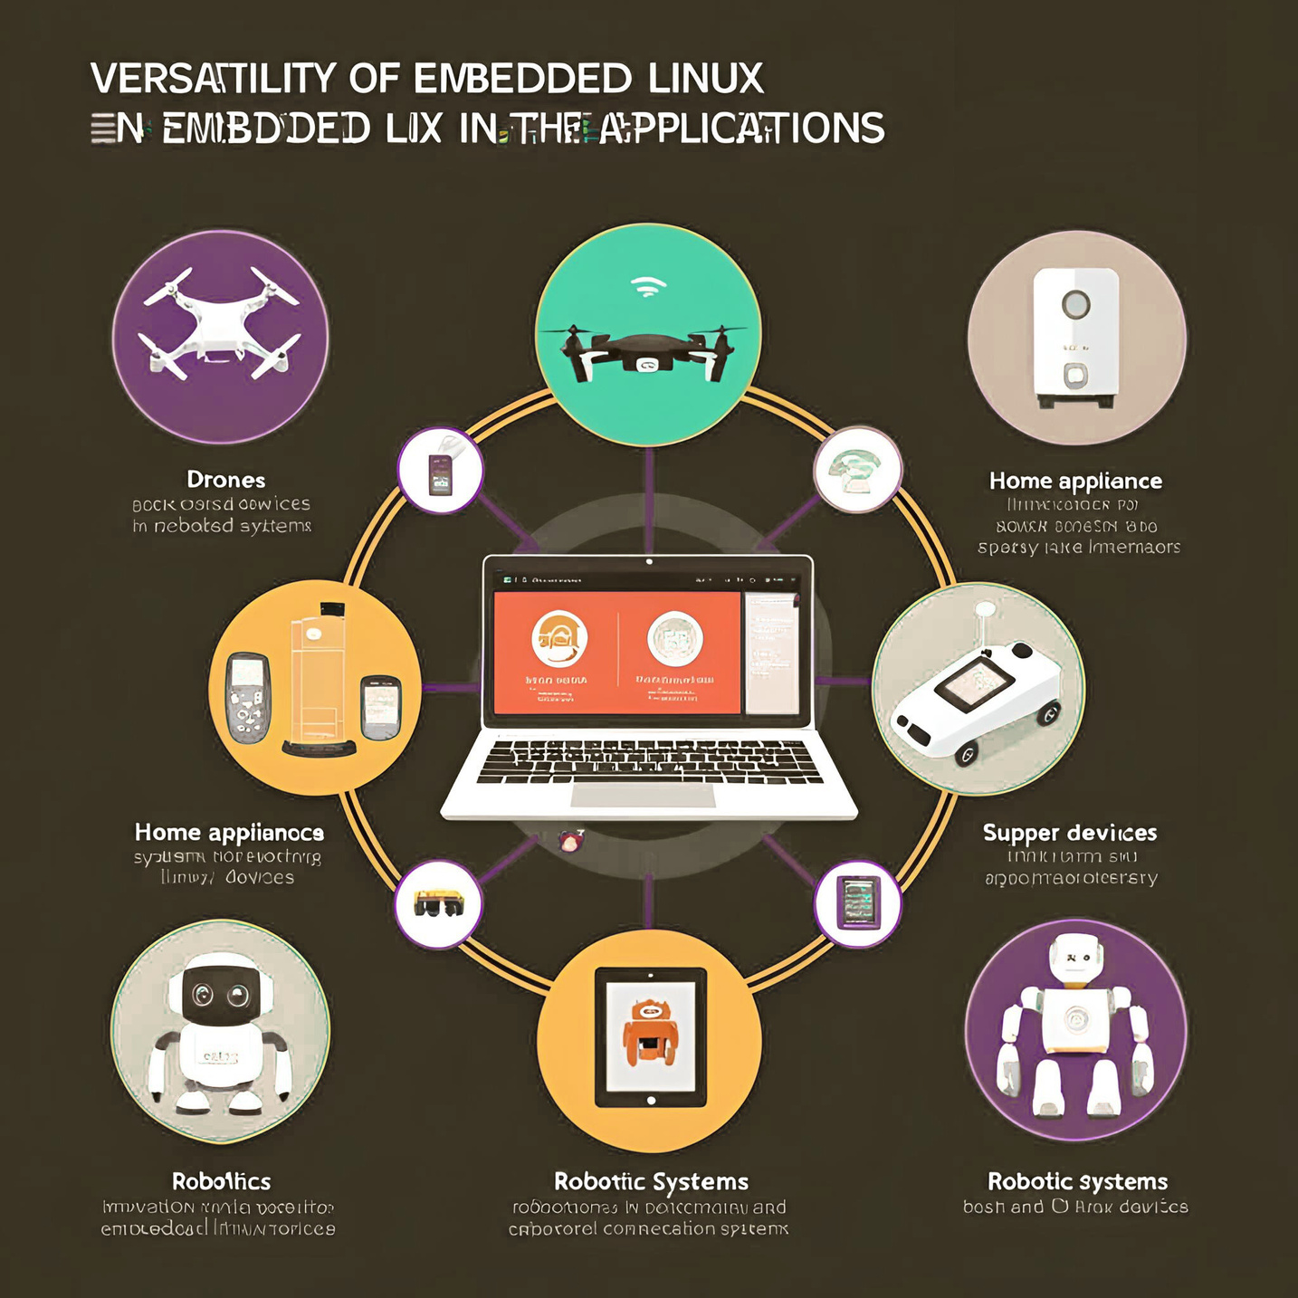

Embedded Linux
Embedded Linux is a lightweight, flexible version of the Linux operating system designed to run on embedded systems like IoT devices, routers, and industrial machines. It offers powerful performance, real-time capabilities, and full control over hardware, making it ideal for building smart, efficient, and cost-effective embedded solutions across various industries.

Slide 5




BENEFITS
Adaptive InfoTech offers rigorous tech training (1 month full-time
or 3 months part-time) with a certificate upon course completion.
This is followed by a 3-month unpaid internship, after which
top performers get a 6-month paid internship at Adaptive
InfoTech, while others receive support for external internship.
INTERNSHIP
CERTIFICATE
PROJECTS
Unpaid internship of 3 months
and Paid internship of 6 months
for top performing
candidates at Adaptive InfoTech
Certificate of course completion from
Adaptive InfoTech
10+ capstone projects
will be done by the
students for hands-on
experience

Slide 6



HANDS-ON EXPERIENCE
Capstone projects
A culminating endeavor where participants apply the
knowledge and skills gained throughout a program to tackle
real-world problems or create a significant deliverable, often
involving research, design, and implementation.

Slide 7


Course Price
Virtual Course
Onsite Practical
3,999
3,999
Module
Mentoring
Certificate
Module
Mentoring
Certificate

Slide 8







Contact Us
Adaptive InfoTech, founded by Rishikeshlalbabu, is a
design house specialising in DSP, Microprocessor,
Microcontroller, FPGA, RF, Firmware, hardware and Software since 2004.
9840786878, 452-2330521
www.adaptit.co.in
training@adaptit.co.in
Adaptive InfoTech

Slide 9


Thanks
www.adaptit.co.in

